Slide 1
Public Housing Resale Market Analysis
Abdullah Sayyid Ayyash, B. Eng

Slide 2
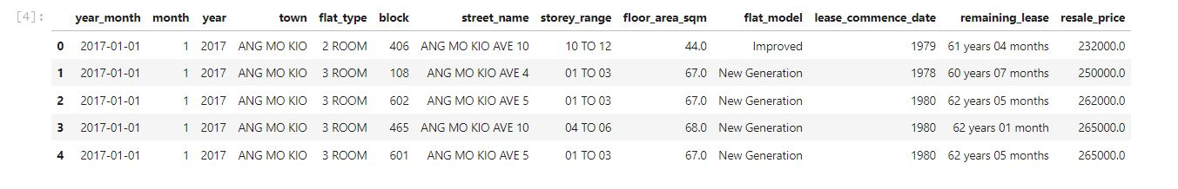
Dataset
Source : https://data.gov.sg/dataset/resale-flat-prices
List price of flats in Singapore for every types in every town since January 2017 until January 2022 each month

Slide 3
Feature Description
Flat Type : type of the flats e.g., 2 ROOM, 3 ROOM etc.
Storey Range : Location of the flats vertically e.g., 10 TO 12 means the flats in between 10th and 12th floors
Floor area sqm : Flats’s area in squared meter
Lease_commence date : Lease starting date
Year remaining lease : remaining years of flat until the flat’s period is end (99 years)
Resale price : Price of the flat at that moment

Slide 4
EDA
Explanatory Data Analysis

Slide 5
Metrics :
Units (number of flats)
Price
Volume (Sum of the transaction)
Notes:
Volume : Assume the table also represent the transaction

Slide 6
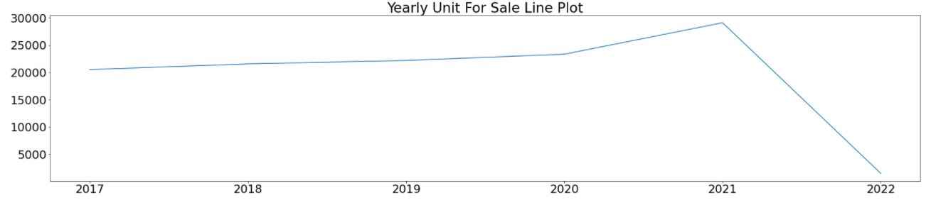
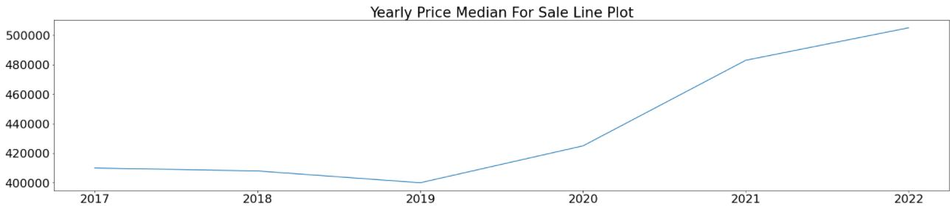
Growth
Notes:
Assume the table also the transaction data
Flats unot for sale always increasing every year not significantly
In 2022 just contain January
Median of price start increase in 2019 and 2020
Ansewring question 6 is the market getting bigger ? Yes because of the two graphics (demand and price)
The more demand, the higher the price

Slide 7
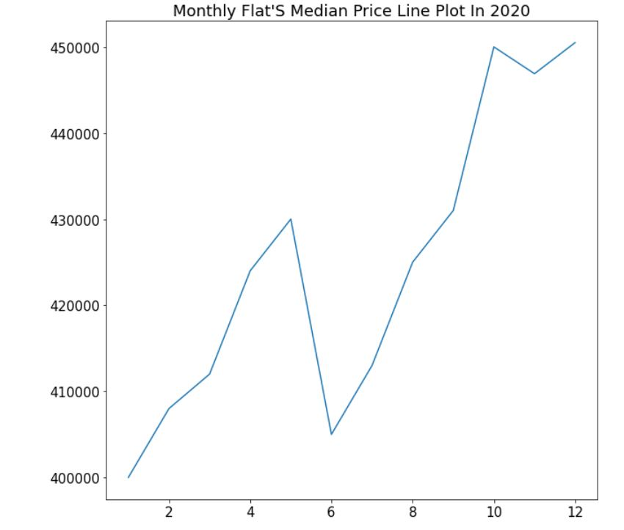
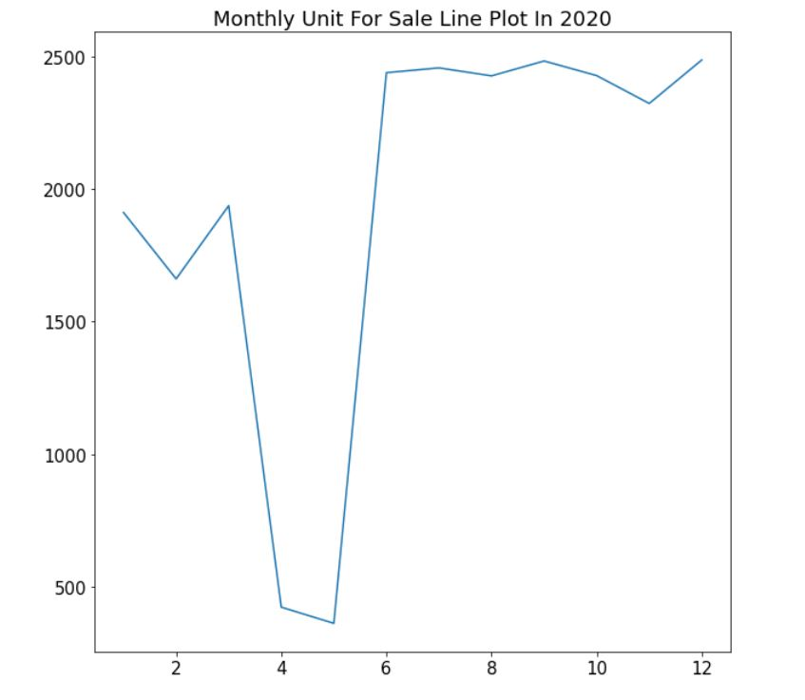
2020
Notes:
Answering the question number 2 :
Decrease significantly in April and Mei (under 500 units) so that
Make the price decline to attract more people to buy the flats

Slide 8
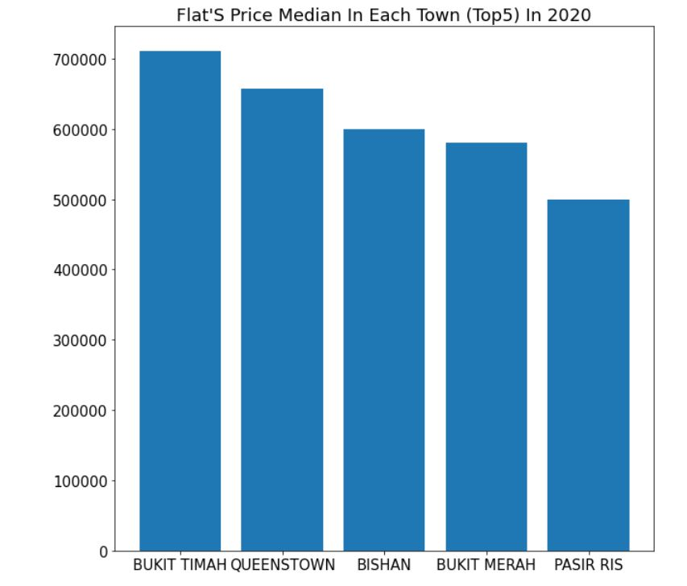
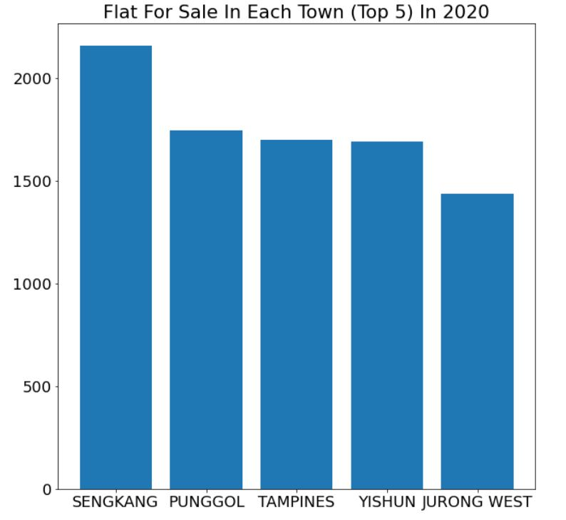
2020
Notes:
Answering the question number 3 :
- Top 5 expensive town in 2020

Slide 9
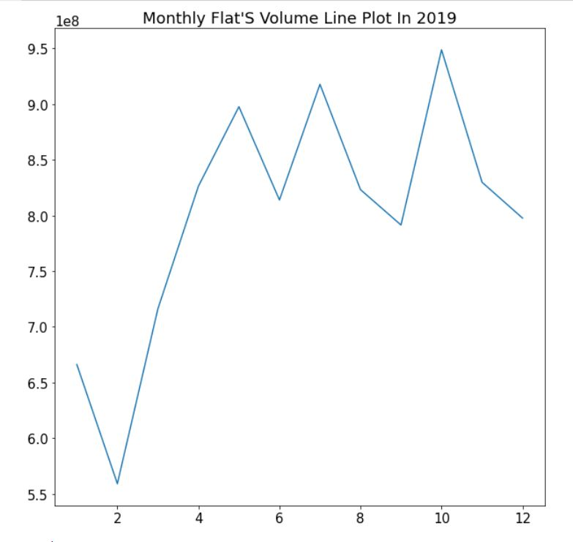
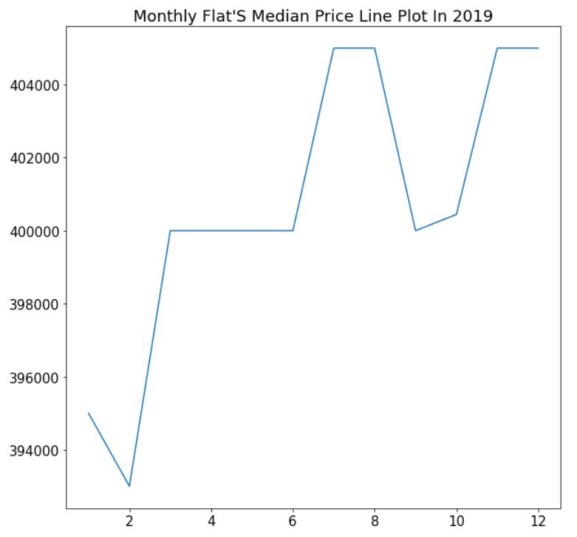
2019
Notes:
- Volume in 2019 fluctuate possibly influenced by the price in 2019 also fluctuating e.g. in July to September

Slide 10
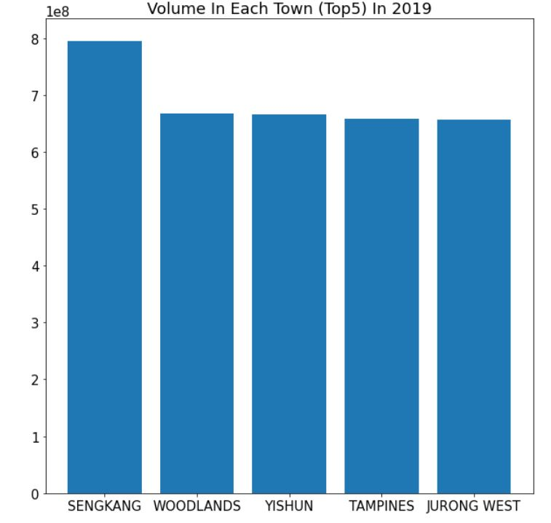
2019
Notes:
Answering the question number 4 :
- Top 5 town that have biggest volume

Slide 11
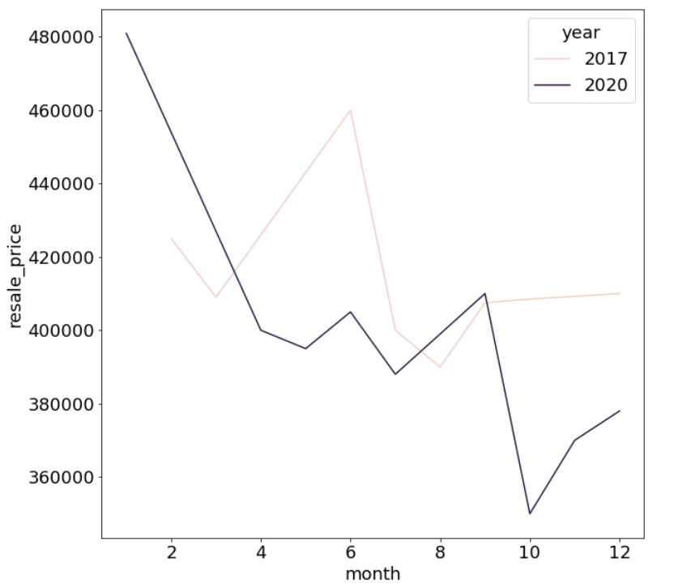
2017 vs 2020
3 ROOM Flat Type in Bukit Timah
Notes:
Because in 2020 Bukit timah gave the most expensive town, it would be interested to go deeper in ther
Answering the question number 5 :
In 2017 the price tend to be stagnant (over all). Highest June, lowest August
In 2020 the price tend to be decrease. The lowest point in Oktober, lower then the lowest point in 2017.
Possibly because the big drop of demand in April 2020 and Mei 2020 (Picture 2) therefor the price decrease in the interest of escalating the demand.

Slide 12
CLASSIFICATION PROBLEM

Slide 13
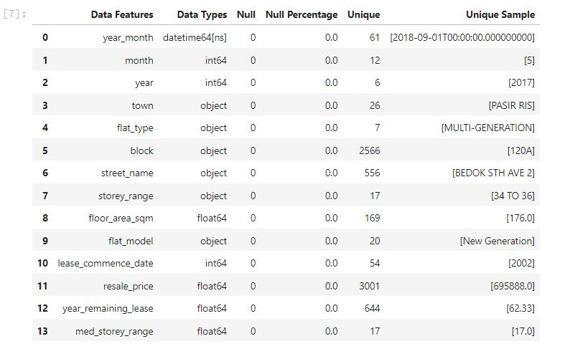
Data Preparation
- Checking the null values (in EDA steps)

Slide 14
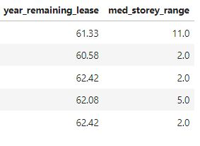
Data Preparation
Change value to numerical
Fields remaining lease and Storey range can be transformed into numerical values
Notes:
Why ? In order to reduce categorical columns so that not too much columns that have to do one hot encoding

Slide 15
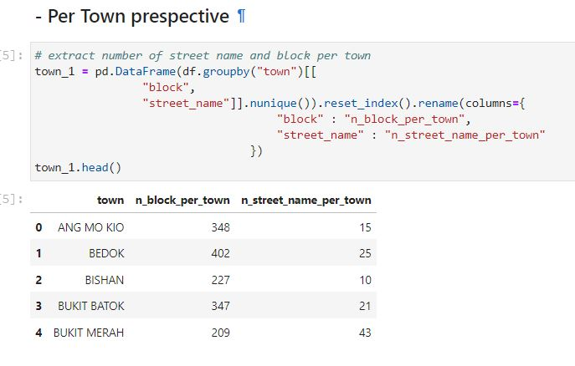
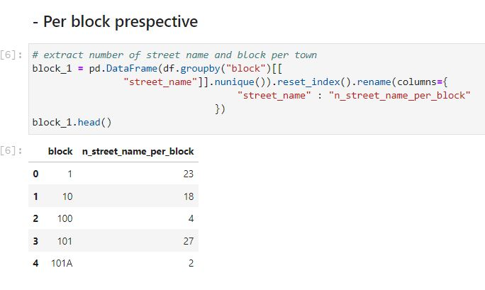
Data Preparation
Data Mining
How many block per town ?
How many street per town ?
How many street per block ?

Slide 16
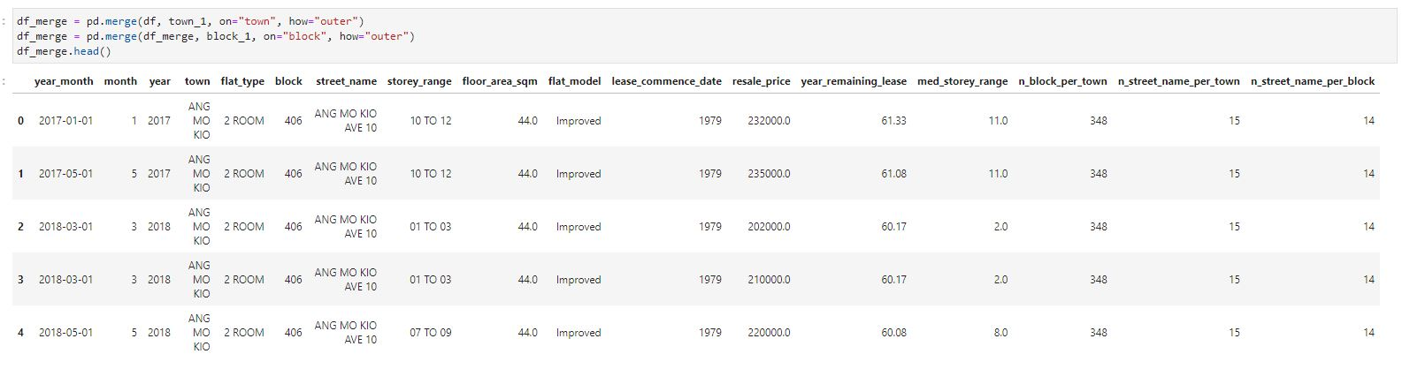
Data Preparation
Joining the table
Base table & Table per town prespective & Table per block prespective

Slide 17
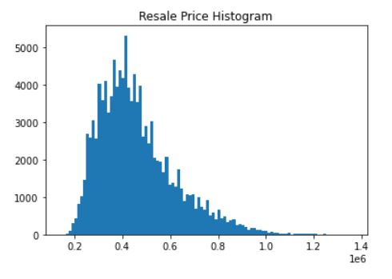
1. Categorize the very affordable, affordable and not affordable
The peak is in 400,000 SGD
we can classify the affordability in 3 classes: 1) Very Affordable (< 400,000 SGD); 2) Affordable (400,000 – 600,000 SGD) and 3) Not Affordable (>600,000 SGD)

Slide 18
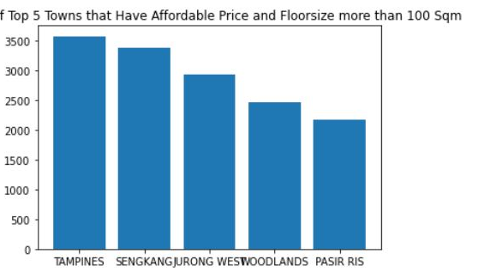
2. Affordable flats tha have floor size more than 100 sqm
Tampines have most proportion of the affordable flats (>100 sqm) around 3500 unit

Slide 19
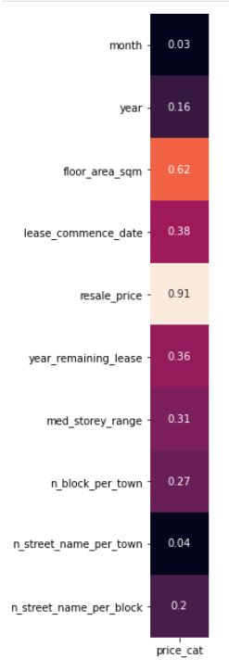
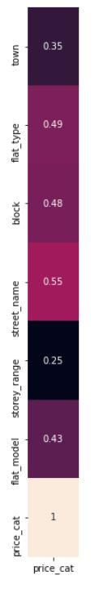
3. Variable that associated to flats affordability
CRAMERS ASSOCIATION
CORRELATION RATIO
Notes:
The affordibilty columns is categorical
Cramers associaton ➔ represent association between 2 categorical fields
Correlation Ratio ➔ represent association between numerical and categorical field
The higher value, the higher they are associated
The resale price has the highest value. It means that price category (affordable, very .. Etc.) Highly associated to resale price. DUH. Self explaining field. ALSO it tells that the categorization (affordable, very .. Etc.) represent the resale price well.

Slide 20
BEGIN MODELLING
Dropping Fields
Change the target field into numerical values
Check Data Imbalance
Splitting Data
Over sampling (if the data imbalance)
Encoding
Scalling
Pipeline
Modelling (Base model)
Evaluation Metrics
Hyperparameter tuning (if needed)

Slide 21
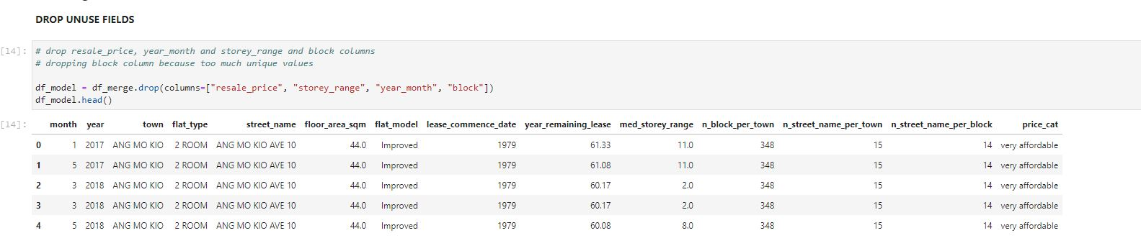
DROPPING FIELDS
Drop :
Reseale Price (self explaining field for the target)
Storey range (already represented in field med_storey_range)
Year_month (already represented in fields year and month)
Block (too much unique values)

Slide 22
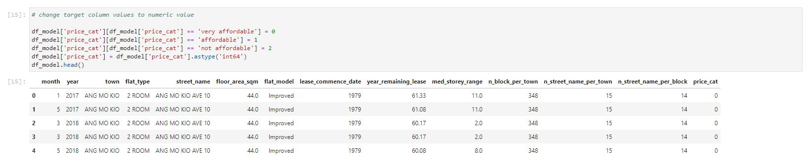
TARGET FIELDS INTO NUMERICAL VALUES
Very affordable = 0
Affordable = 1
Not affordable = 2

Slide 23
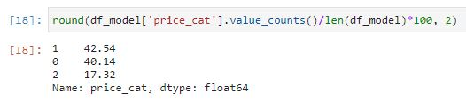
Data Imbalance Checking
IMBALANCE !

Slide 24
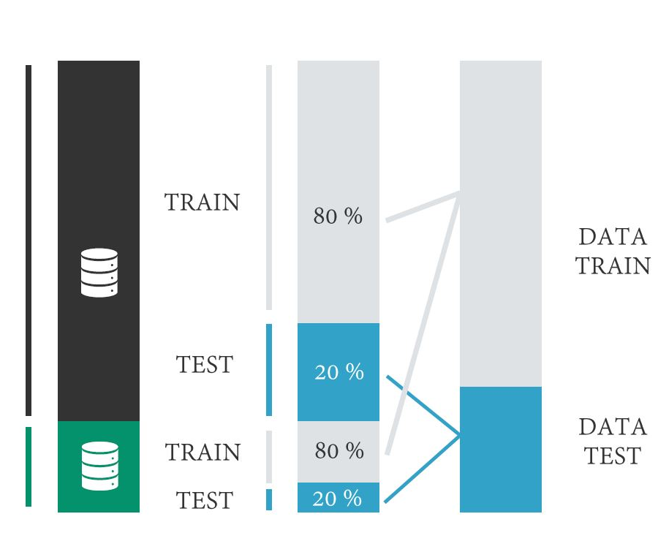
SPLITTING DATA
Example for target field that have only 2 unique values
TRAIN : 80%
TEST : 20%

Slide 25
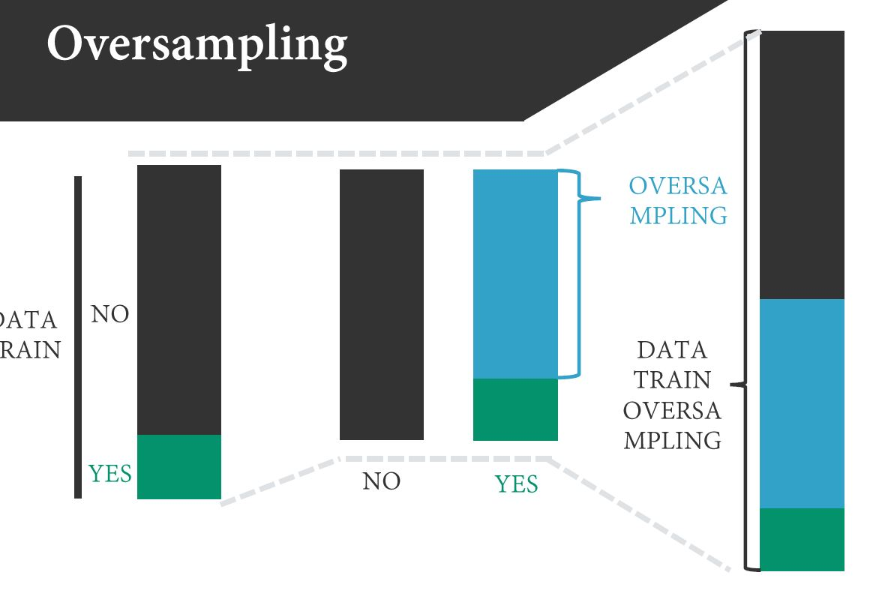
OVERSAMPLING
Oversampling ONLY for Train dataset

Slide 26
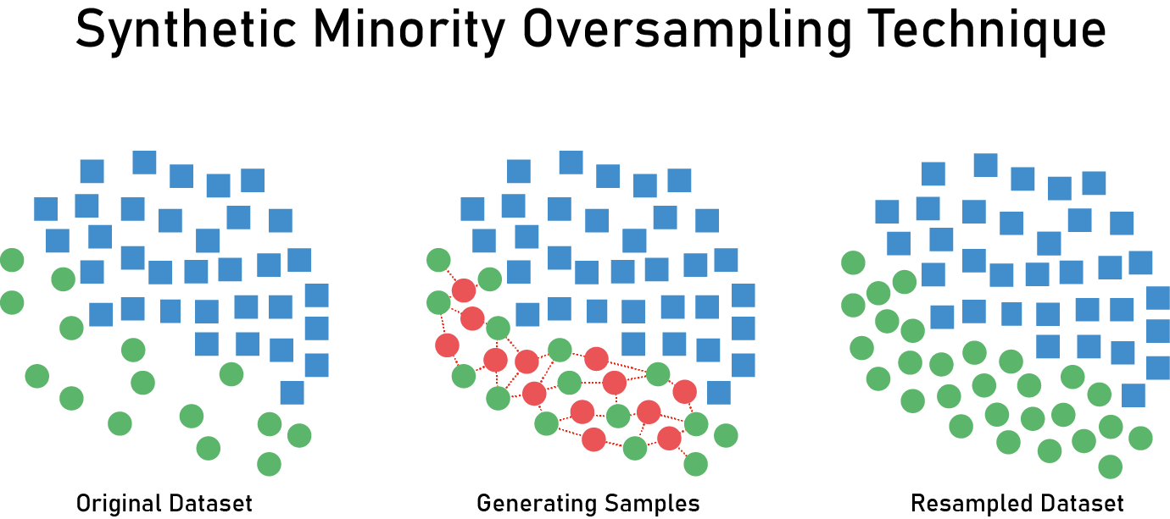
OVERSAMPLING
Using SMOTE techniques. Oversampling ONLY for Train dataset
Source : Link

Slide 27
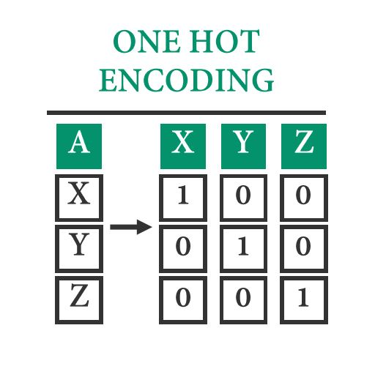
ENCODING
ONLY for Fields that have categorical values. Use One Hot Encoding

Slide 28
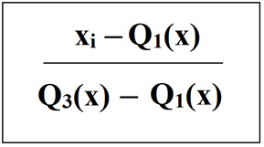
SCALLING
ONLY for fields that have numerical values. Using Robust Scalling
Source : link
Notes:
Why using robust scalling ? It is more suitable for data that have outliers. Robust Scaller make the value only in range IQR

Slide 29
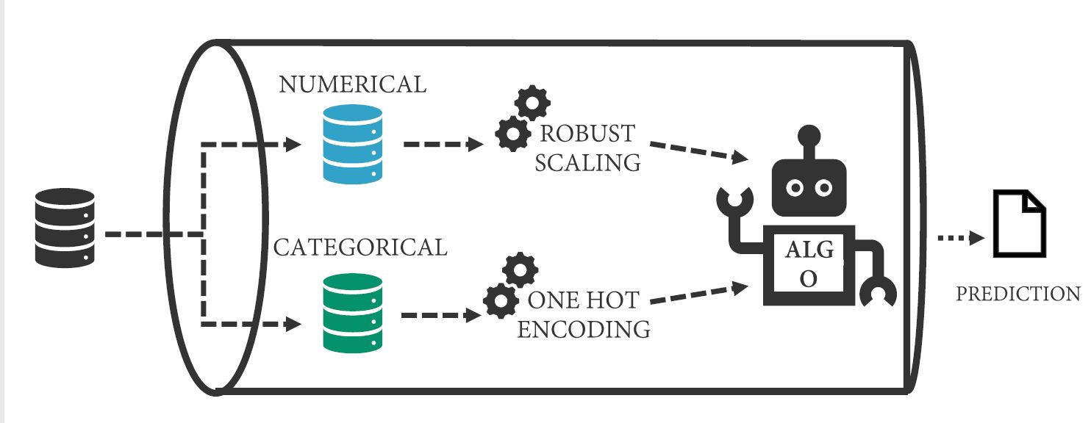
PIPELINE

Slide 30
MODELLING
Logistic Regression
Support Vector Machine (Classification)
Decision Tree Classification

Slide 31
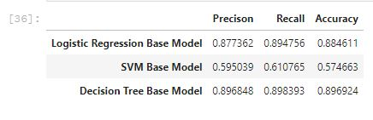
Evaluation Metrics

Slide 32
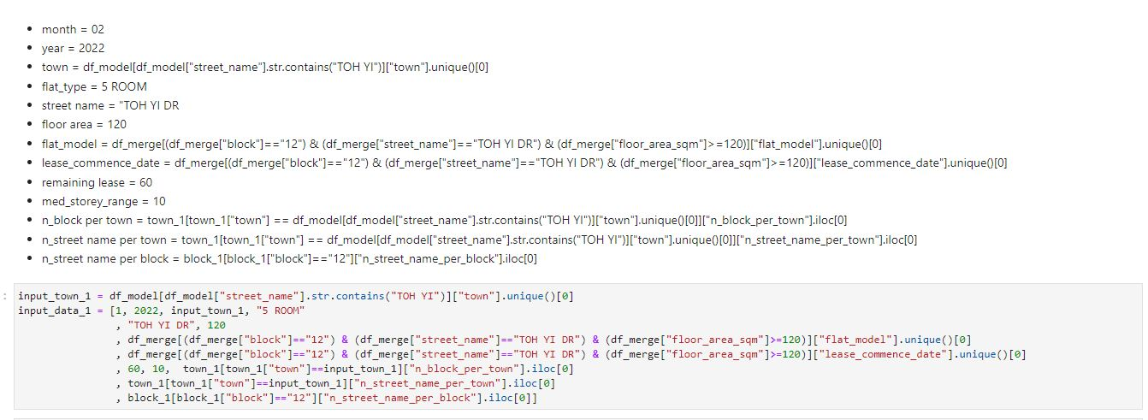
4. a. Is it affordable for flat at Blk 12 TOH YI IDR, 5 ROOM type, floorsize 120 sqm and remaining lease at least 60 years ?
Preparing for the input, Assume the price for this month and this year

Slide 33
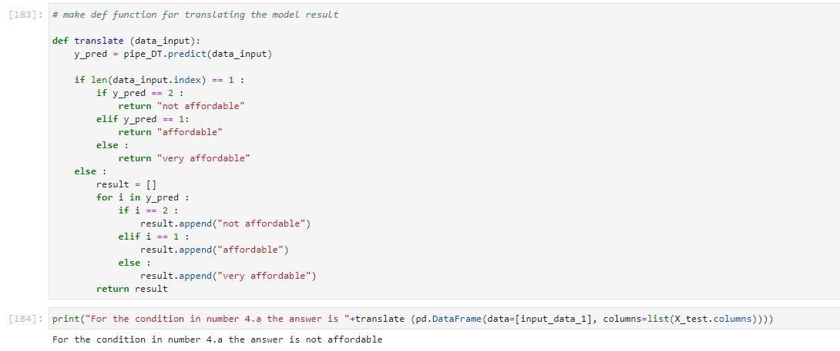
4. a. Is it affordable for flat at Blk 12 TOH YI IDR, 5 ROOM type, floorsize 120 sqm and remaining lease at least 60 years ?
Prediction

Slide 34
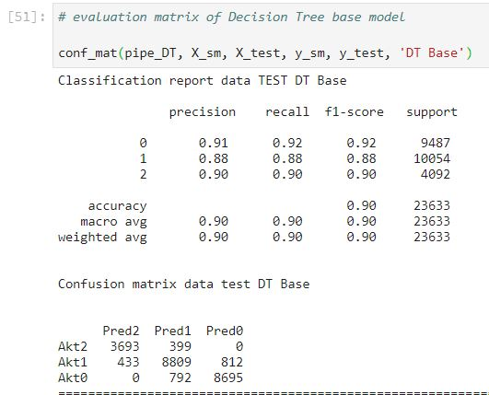
5. Do you think you should go to view the flat? How confident are you with the assessment ?

Slide 35
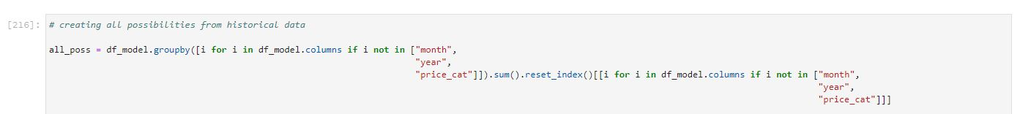
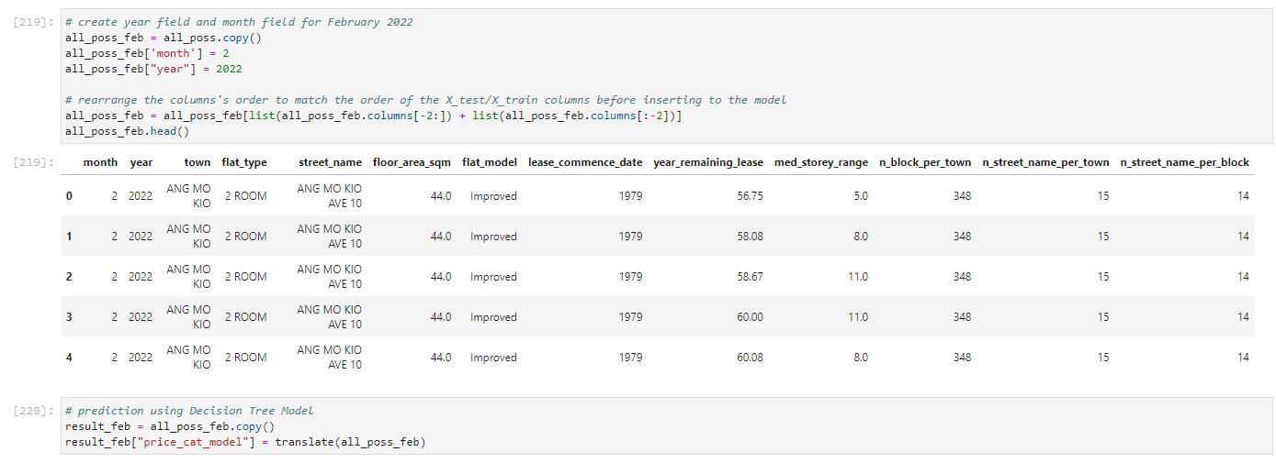
6. Suggestion for Flats (floor area >= 90 sqm and year remaining lease at least 60 Years (>=60)
Creating all possibilities based on historical data
Add value for month and year == February 2022

Slide 36
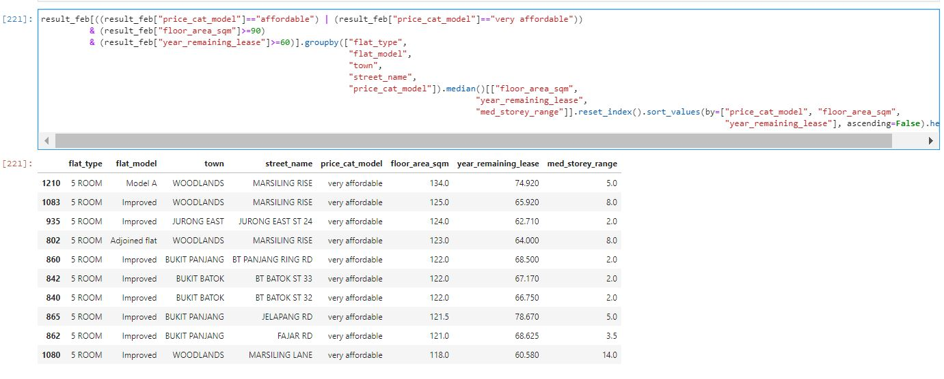
6. Suggestion for Flats (floor area >= 90 sqm and year remaining lease at least 60 Years (>=60)
Predicting using DT Model
Result

Slide 37
REGRESSION PROBLEM

Slide 38
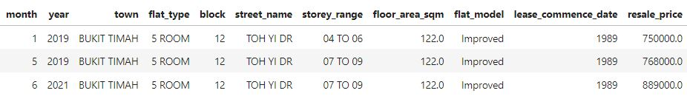
1. The same case like in Classification (Blk 12 TOH YI DR. It’s a 5-room flat so the size is approximately 120 sqm), but the price is 700,000 SGD. is the price reasonable ?
Based on the historical data, the minumum price of flats in 12 TOH YI DR with 5 ROOM type is 750,000 SGD. That price was 3 years ago. The newest data (2021) is around 889,000 SGD and every year it the price should be increase. In conclusion, it is unreasonable if the price is 700,000 SGD. you should check the flat if it’s necessary.

Slide 39
2. The Reasonable Price ?
BEGIN REGRESSION MODELLING

Slide 40
BEGIN REGRESSION MODELLING
Dropping Fields
Splitting Data
Encoding
Scalling
Pipeline
Modelling (Base model)
Evaluation Metrics
Hyperparameter tuning (if needed)

Slide 41
MODELLING
Linear Regression
Support Vector Machine (Regression)
Decision Tree Regression

Slide 42
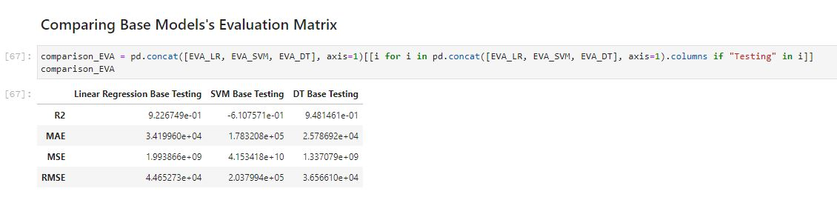
Evaluation Metrics

Slide 43
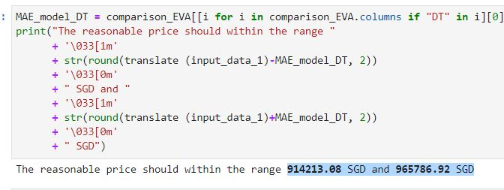
2. The Reasonable Price ?

